Slide 1
Beyond Traditional Methods: AI-Powered Retail Insights
Done by Tan Li Ying (Lizz)
Notes:
How AI helps retailers extract valuables insights from their overgrowing data.

Slide 2

Challenges of Traditional Data Analysis in Retail
Traditional data analysis methods such as spreadsheets and basic statistical analysis are often inadequate for modern retail data due to:
Overgrowing data volume and complexity
Data quality issues
Visualization limitation
Predictive analytics tools limitation
Scalability
Notes:
Data Volume and Complexity:
Retail generates massive daily data, from point-of-sale transactions to customer behaviour tracking.
Traditional methods struggle with efficiently processing and analysing large volumes.
Handling diverse data types (structured and unstructured) is a challenge.
Data Quality and Consistency:
Retail data is prone to errors, inconsistencies, and missing values.
Integrating scattered data from different systems is difficult.
Data Visualization Limitations:
Complex relationships and patterns in retail data are not effectively conveyed by traditional visualization techniques.
Lack of interactive exploration capabilities hinders uncovering hidden trends.
Predictive Analytics:
Traditional methods are limited in forecasting future trends or outcomes.
Complex predictive models (e.g., machine learning) require specialized tools.
Scalability and Efficiency:
Computationally inefficient as data volumes grow.
Manual processes are time-consuming and error-prone.

Slide 3

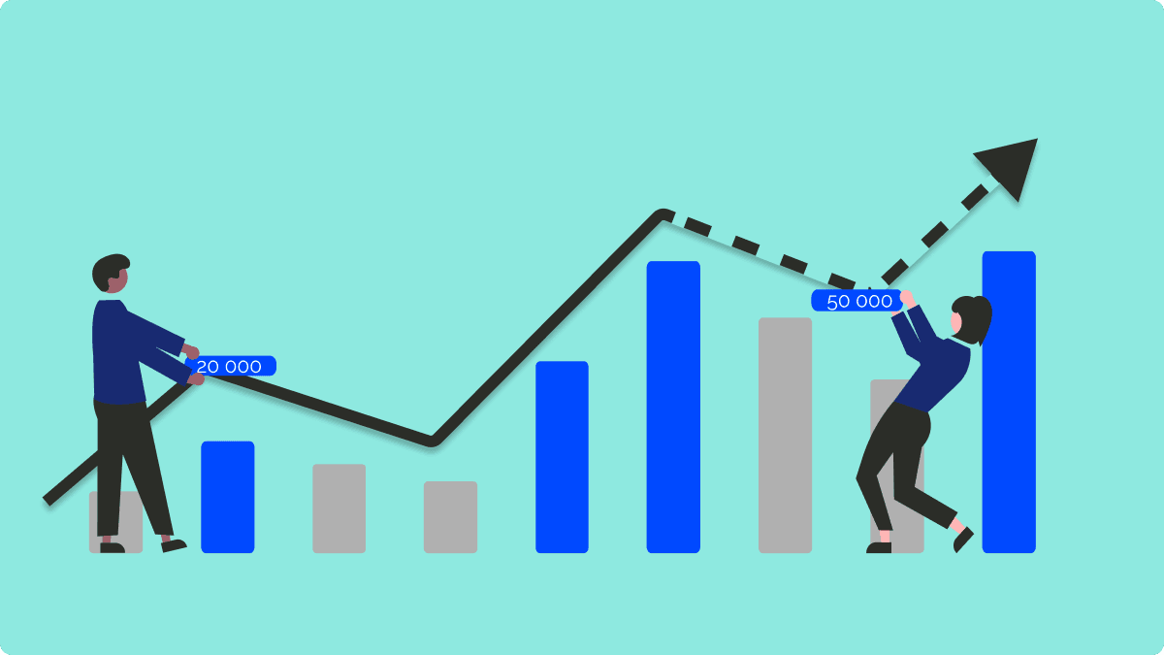
Specific Challenges in Retail Data Analytics
Customer Segmentation
Diverse customer profiles and behaviours.
Data quality issues.
Sales Forecasting
Product availability and pricing.
Economic conditions.
Demand Forecasting
Seasonality, promotions, and external factors.
Product life cycle.
Notes:
1. Customer Segmentation
Diverse customer profiles: Customers have varied demographics, purchase behaviours, and preferences, making it difficult to accurately categorize them into distinct segments.
Dynamic customer behaviour: Customer preferences and behaviours can change over time, making it challenging to maintain accurate segmentation models.
Data quality issues: Incomplete or inaccurate customer data can hinder the effectiveness of segmentation efforts.
2. Sales Forecasting
Product availability: Stockouts or excessive inventory can impact sales, making accurate forecasting difficult.
Pricing strategies: Changes in pricing can affect demand and sales, requiring careful consideration.
Economic conditions: Economic factors like inflation, interest rates, and consumer confidence can influence sales.
3. Demand Forecasting
Seasonality and promotions: Demand for products often fluctuates due to seasonal factors and promotional activities, making accurate forecasting challenging.
External factors: Economic conditions, competitive landscape, and supply chain disruptions can significantly impact demand.
Product life cycle: Demand for products varies throughout their life cycle, from introduction to maturity and decline.

Slide 4
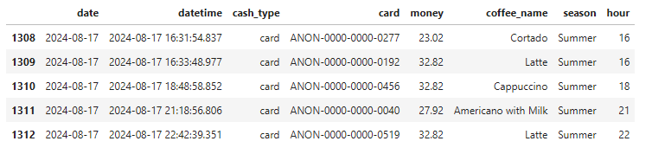

About the Dataset
Contain detailed record of coffee sales from a vending machine spans from March 2024 to present time. (latest update is till 28-Aug-2024)
Dimension of the dataset : (1395, 6)
Description of the columns:
date – Date of purchasing
datetime – Datetime of purchasing
cash_type – Cash or card payment
card – Anonymous card number for each unique customer that used card purchasing
money – Amount of money in Ukrainian hryvnias
coffee_name – Coffee type
Added columns:
season – Season of the year
hour – Hour of the day at point of purchasing

Slide 5
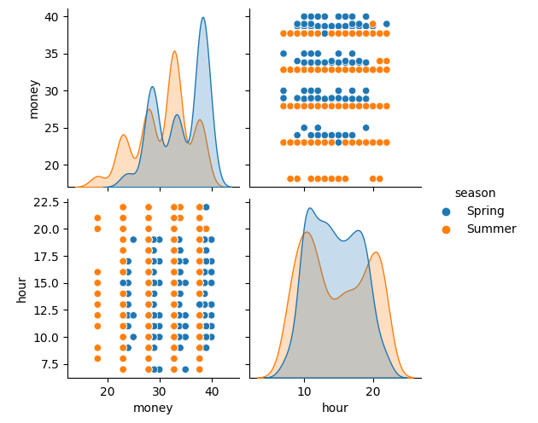
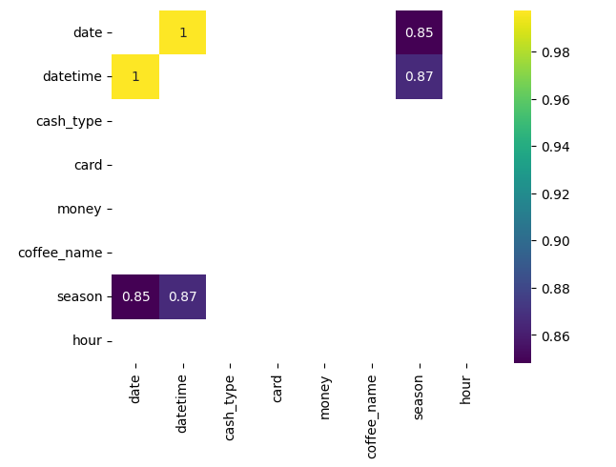
About the Dataset
Pair plot
Heatmap
Notes:
Heatmap:
No strong correlation between any of the column except the date, datetime and season
Pairplot:
From the money distribution, can see there is more on high value transaction.
The hour distribution is evenly spread with peak period in the early morning.
There is also some slight difference in pattern for both season.
Analyze of the pairplot
Money: The distribution is skewed to the right, indicating that there are a few high-value transactions.
Money vs. season: The scatterplot shows that there might be a slight difference in spending patterns between seasons, but it's not very clear.
Hour: The distribution is relatively uniform, suggesting that transactions are spread fairly evenly across different hours. The peak hours are around 9-10am where the working hours started.
Hour vs. season: The scatterplot doesn't reveal any strong relationship between hour and season.
Seasonal Differences: The density plots for money and hour by season show some differences. For instance, the distribution of money might be slightly different in the summer compared to the spring. However, these differences are not very pronounced.
Money vs. hour: There seems to be a slight negative correlation, suggesting that higher amounts of money might be spent at earlier hours. However, this relationship is not very strong. Money vs. season: The scatterplot shows that there might be a slight difference in spending patterns between seasons, but it's not very clear.

Slide 6
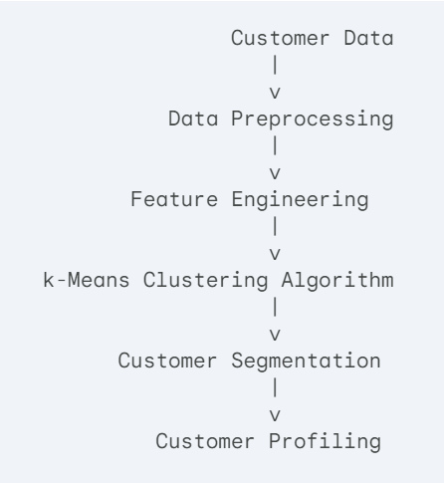
kMeans for customer segmentation: System architecture and design
Customer Data : Dataset from Kaggle
Data Preprocessing : Removed cash payment customers
Feature Engineering : Use factors that will help me understand customer spending behaviour. Total spending, average spending, purchase frequency, preferred coffee
kMeans Clustering Algorithm : Used k value = 3
Customer Segmentation : Visualized the segmentation using scatter plot chart
Customer Profiling : Analyse the chart
Notes:
Customer Data (Dataset) : This is the raw data collected from various sources like point-of-sale systems, loyalty programs, and customer surveys. It can include information such as purchase history, demographics (age, gender, location), and customer interactions (e.g., email open rates, website visits).
Data Preprocessing (Remove cash payment customer) : This step involves cleaning and preparing the data for analysis. It might include tasks like handling missing values, removing outliers, and normalizing or standardizing features to ensure they are on a comparable scale.
Feature Engineering (Total spending, average spending, purchase frequency, preferred coffee) : This is where new features are created or existing ones are transformed to improve the clustering results. For example, you might create a feature representing the average purchase amount per visit or the recency of the last purchase.
k-Means Clustering Algorithm (Choose k value = 3) : The core of the system. It iteratively assigns data points to clusters based on their distance to the cluster centroids. The number of clusters (k) is a hyperparameter that needs to be determined.
Customer Segmentation (Scatterplot chart) : Once the clustering is complete, customers are grouped into distinct segments based on their assigned clusters.
Customer Profiling (Analyze the chart) : This involves analyzing the characteristics of each customer segment to understand their preferences, behaviors, and needs. This information can be used for targeted marketing campaigns, product recommendations, and personalized customer experiences.

Slide 7
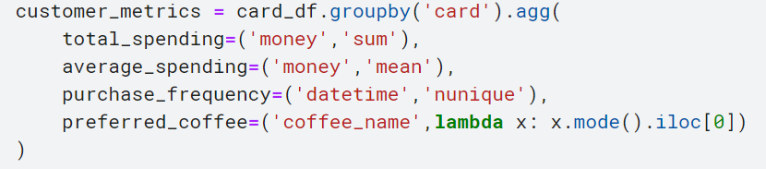
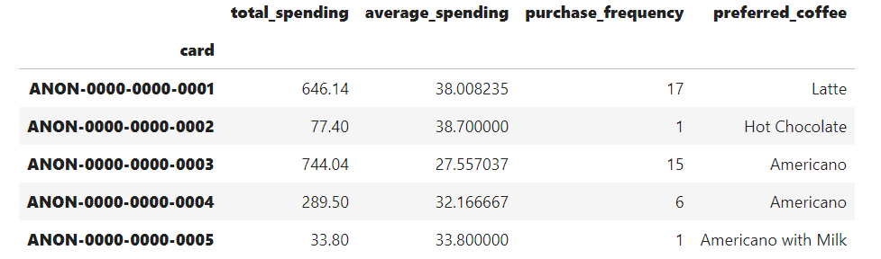
kMeans for customer segmentation: Coding for feature engineering
Notes:
customer_metrics = card_df.groupby('card').agg(...):
Groups the card_df DataFrame by the 'card' column, creating separate groups for each unique card.
Applies the aggregation functions specified within the agg() method to each group.
total_spending=('money', 'sum'):
Calculates the sum of the 'money' column for each card group, representing the total spending on that card.
average_spending=('money', 'mean'):
Calculates the mean of the 'money' column for each card group, representing the average spending per transaction on that card.
purchase_frequency=('datetime', 'nunique'):
Calculates the number of unique values in the 'datetime' column for each card group, representing the number of different times on which purchases were made with that card.
preferred_coffee=('coffee_name', lambda x: x.mode().iloc[0]):
Applies a lambda function to the 'coffee_name' column for each card group.
The lambda function calculates the mode (most frequent value) of the coffee names for that group.
The iloc[0] part is used to extract the first mode in case there are multiple modes with equal frequency.

Slide 8
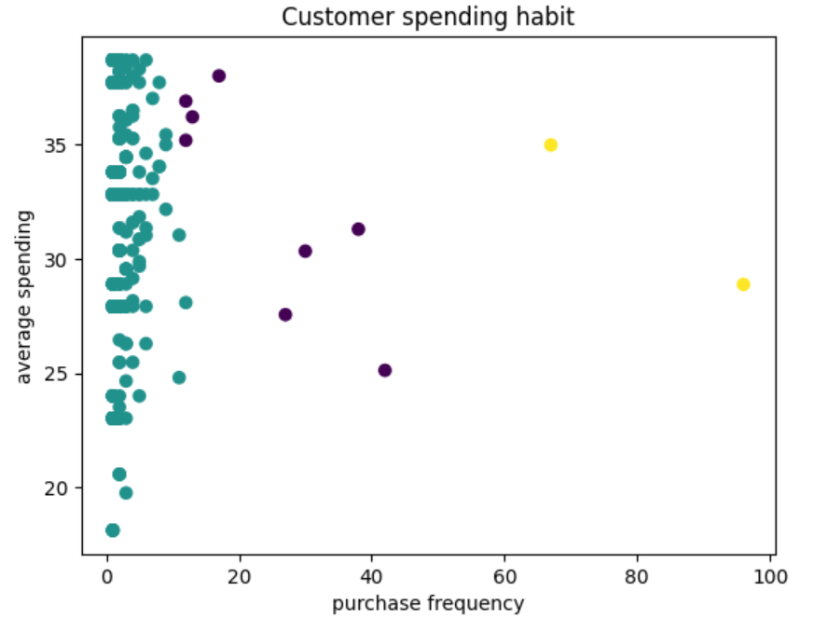
kMeans for customer segmentation: Result of the model
Green Cluster
Customer looking for premium coffee and willing to pay a premium price. However, also some distinct customer at bottom buying low-value purchase.
Blue Cluster
Regular customers looking for value and convenience
Yellow Cluster
A mix of customers who either high-value buyers or regulars buyers seeking value. They are both highly engaged and frequent customers.
The clusters might also represent different stages of customer lifecycle. For example, the green cluster represent new customers or customer who happened to pass by while the other two clusters represent loyal and repeat customer.

Slide 9

kMeans for customer segmentation: Challenges faced and problem solving approach
Challenge:
Cash payment customer…
Solving Approach:
Remove them out because they only take up 6% of the whole dataset. 6% is considered insignificant.

Slide 10
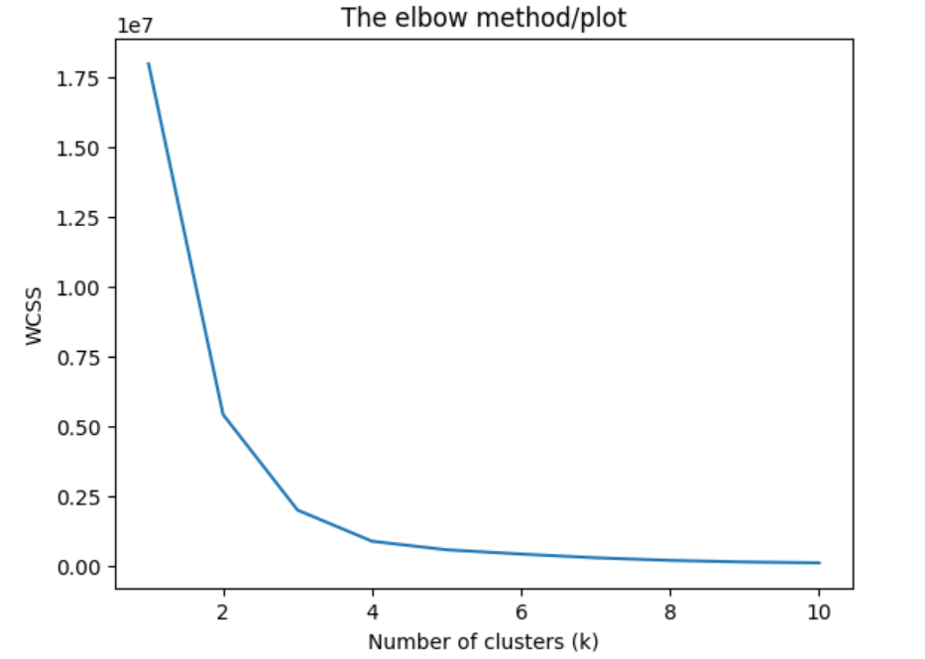
kMeans for customer segmentation: Challenges faced and problem solving approach
Challenge:
Deciding the best k value
Solving Approach:
Plot the elbow port and decided with k = 3 where the SSE (Sum of Squared Error) begins to flatten out and see an inflection point.

Slide 11

kMeans for customer segmentation: Potential future enhancement
Use alternative clustering algorithms such as Hierarchical Clustering to see if they provide different insights.

Slide 12
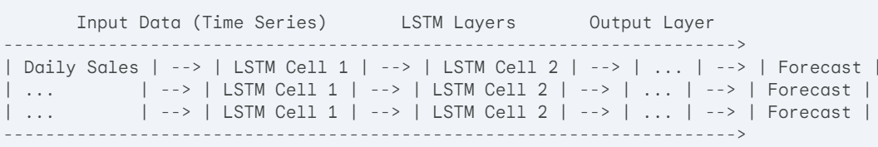
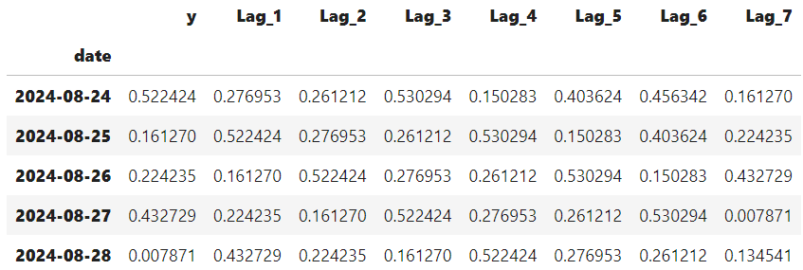
LSTM for daily sales forecast: System architecture and design
LSTM Layers
LSTM Cells
The core of the LSTM Model
These cells are designed to capture long-term dependencies in the data.
They consist of three gates (input, forget and output) that regulate the flow of information through the cell.
Each LSTM cell maintain a hidden state and a cell state. These states store information about the past sequence, allowing the model to learn long-term patterns.
Notes:
Data Structure:
Time Series : date column
Target Variable : y represent the total sales amount for the day dated.
Lagged Variables : Lag_1 to Lag_7 (y for the 7 previous day), providing historical context.
LSTM Model Architecture:
Input Layers : Lagged variable was input into the LSTM Network
LSTM Layers
Output Layer : The final layer of the model. It typically produces a single output value, representing the prediction for the target variable y.

Slide 13
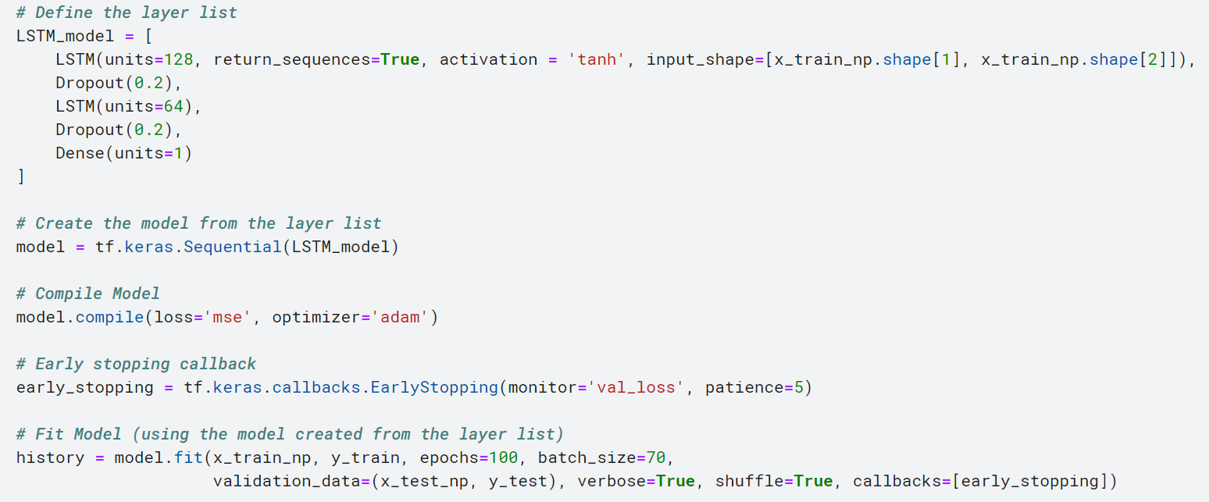
LSTM for daily sales forecast: Coding for LSTM model training

Slide 14
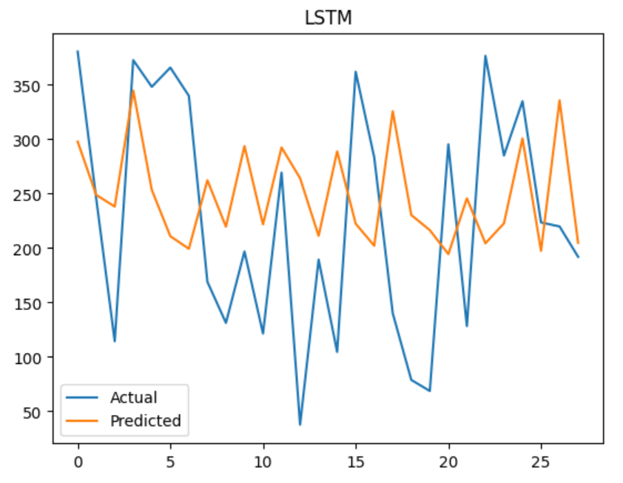
LSTM for daily sales forecast: Result of the LSTM model
RMSE Score : 115.93652712993645
The chart shows the actual (blue) vs. predicted (orange) values of the sales amount for each day.
The RMSE score indicates the average error between predicted and actual, on average, off by $115.93.
From the chart, the predicted value follows the general trend of the actual values, suggesting the model has captured the underlying pattern.
However, there seems to be a slight lag between predicted and actual, indicating the model might be struggling to capture short-term fluctuations.

Slide 15
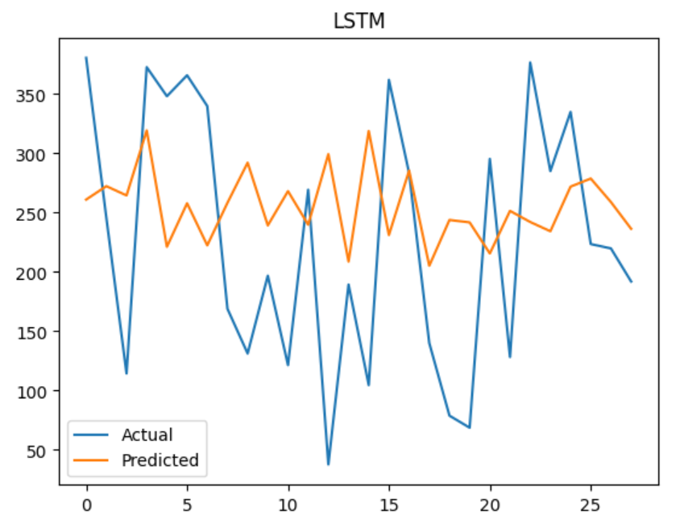
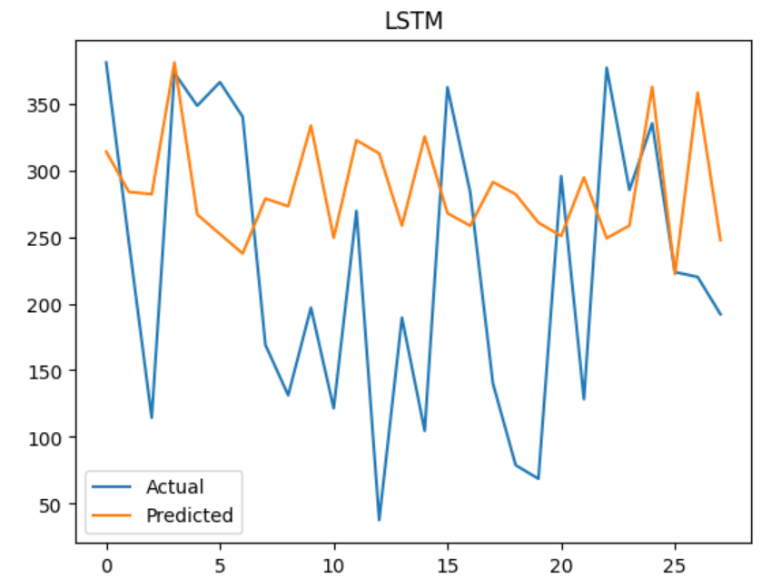
LSTM for daily sales forecast: Challenges faced and problem solving approach
Initial result
RMSE:
117.44 units
Worse result
RMSE:
125.75 units
Best result
RMSE:
115.94 units
Challenge:
Improving the model performance
Solving Approach:
Adjusting the LSTM units
Adding activation function
Input early stopper to minimize lose
Added dropout layer to prevent overfitting
Notes:
Visual Observations:
Overall Trend: Both models seem to capture the general trend of the actual data, suggesting that they are able to learn the underlying pattern.
Lag: Both models exhibit a slight lag between the predicted and actual values. This might indicate a challenge in capturing short-term fluctuations.
Outliers: There are a few outliers in both models, where the predicted values deviate significantly from the actual values.
Accuracy: Based on the visual representation, it's difficult to definitively say which model is more accurate. Both models appear to have similar levels of accuracy.

Slide 16
LSTM for daily sales forecast: Potential future enhancement
Continue to experiment with different hyperparameters such as learning rate, batch size, number of epochs, and LSTM units to find the optimal configuration.
Try rolling LSTM to see if it gives a better performance.

Slide 17
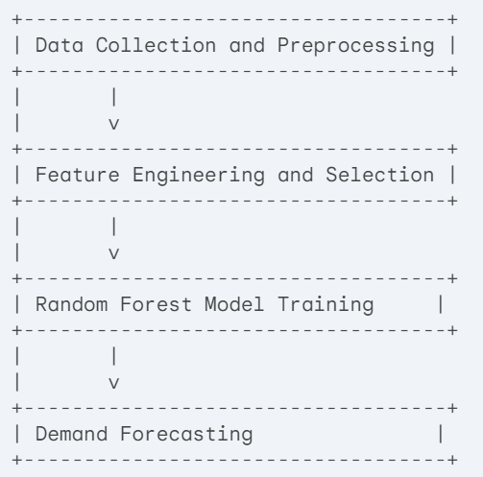
Random forest classifier for product demand forecast: System architecture and design
Data Collection (Dataset) and Preprocessing (Convert all non numeric dtype data into numerical label)
Featuring Engineering : date, card, money, season and hour
Random Forest Model Training
Train : Test Split = 80% : 20%
Number of trees = 100
Demand Forecasting : The model uses its learned patterns to forecast the expected product demand.

Slide 18
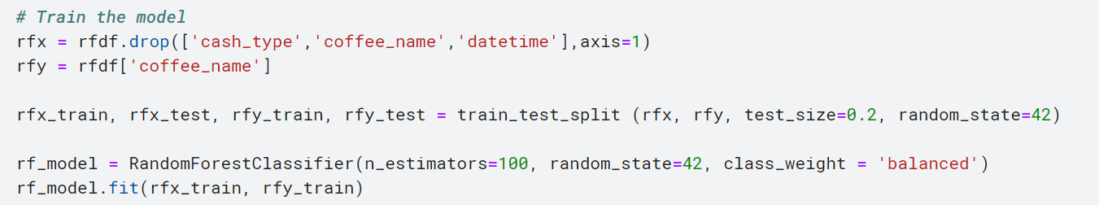
Random forest classifier for product demand forecast: Coding for RFC model training

Slide 19
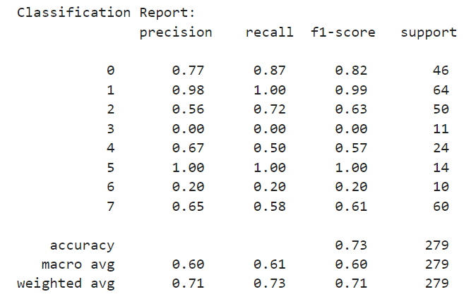
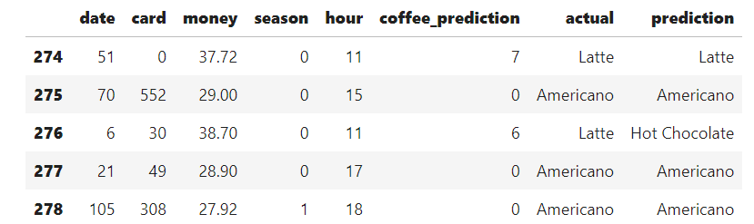
Random forest classifier for product demand forecast: Result on the RFC model
EVALUATION
MODEL PREDICTION
The model demonstrates moderate accuracy of 73% in predicting coffee orders.
While the model performs well for some class, specially class 0.
However, it struggles with other, particular class 3.

Slide 20
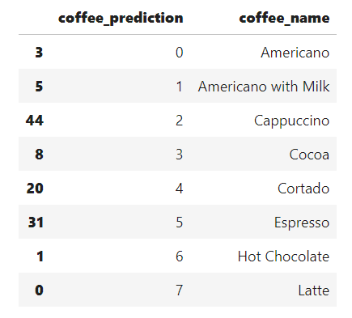
Random forest classifier for product demand forecast: Challenges faced and problem solving approach
Challenge:
Could only use numeric datatype to train the model. Cannot use astype function because my date is in datetime dtype
Solving approach:
Use LabelEncoder from sklearn to convert the datatype to numeric datatype

Slide 21
Random forest classifier for product demand forecast: Potential future enhancement
Experiment with different hyperparameters such as number of trees, maximum depth, minimum sample split, and minimum samples leaf to find the optimal configuration
Try different model like support vector machines or neural networks to see if they perform better compared to RFC

Slide 22

CONCLUSION
Kmeans FOR Customer segmentation
RNN (LSTM) for sales forecasting
RANDOM FOREST FOR DEMAND FORECAST
kMeans model is simple, scalable and interpretable. It helps retailers to understand their customers and tailor marketing strategies.
LSTM model provides accurate sales forecasting, can handle seasonal patterns and can adapt to changing market conditions. It offer a powerful tool for sales forecasting, capable of handling complex time series data and capturing long-term dependencies.
Random forest classifier model has the ability to handle categorical data and reduce overfitting. It can provide accurate forecasts and identify key factors influencing demand.
AI help retailers to enhance customer satisfaction, increase sales, reduce costs, and gain a competitive edges against their competitors by extracting valuables insights from the data.

Slide 23
The end

